Slide 1

JAD:- Joint Application And Design
By Devendra Rai
IT-2k19-14

Slide 2

What is JAD
It is defined as a structured approach in which user, managers and analysts work together to specify or review system requirements.
IBM coined the term joint application design (JAD) in 1970, but some experts prefer joint application development.
The key idea to organize a team consisting of major users, managers, and systems analysts and to charge that team with quickly determining, in an intensive session, the requirements for a proposed new or replacement information system.

Slide 3
History of Joint Application Development
Joint Application Development is developed by Chris Morris of and Tony Crawford during late 1970s .
The aim to improve client satisfaction.
it has been applied in numerous industry sectors which has produced excellent products.

Slide 4



Participants in JAD
Facilitator/session leader
IT Representatives
End-User
Scribe
Observer

Slide 5
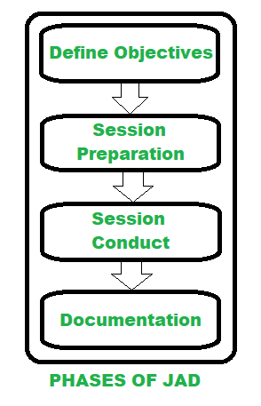
The primary steps in a JAD session.
Organize JAD team
Develop JAD workshop
Locate JAD facilities
Conduct JAD session
Finalize JAD report

Slide 6
Organize JAD team
The members of a JAD team consist of
End users:- from the relevant business functional areas, managers from those same functional areas, systems analysts etc.
The moderator:- or session leader is usually the senior systems analyst or information consultant.
A scribe:- takes notes, records all discussions, and organizes and compiles the necessary documents.

Slide 7
Develop JAD workshop
The JAD workbook consists of
A management definition guide,
Information relevant to the project,
Any special criteria or constraints Any assumptions,
An overview of existing technology and standards,
A statement of the system’s scope and objectives, and Information about the existing system and/or relevant new technology.
The purpose of the workbook is to help the team members understand the proposed project.

Slide 8
Locate JAD facilities
As a minimum, a conference room large enough to accommodate all the Team members and equipped with whiteboards or chalkboards,
An overhead projector, and a slide projector must be available.
With the emergence of the electronic meeting systems (EMS),
Group decision support systems(GDSS), and computer aided software engineering (CASE) tools,
Additional requirements might include computers for conducting an electronic meeting, teleconferencing facilities, and a master station equipped with case software.

Slide 9
Conduct the JAD session
A JAD session is an intensive (typically) two- or three-day meeting of the complete JAD team.
Team members are expected to give the JAD session their complete attention, scheduling no other conflicting activities. JAD session consist of following :-
Preparation
The session
Brainstorming
Investigation, consolidation, resolution, and tabulation

Slide 10

Finalize JAD report
After the JAD session is concluded the responsible systems analysts or information consultants update the necessary documents and prepare a final report that summarizes all discussions, facts, findings, and conclusions.
They then construct a plan for action and a schedule for developing the system. If follow-up sessions are required, they collect the required additional information.

Slide 11


Why use JAD
Accelerate development process /selection process.
Increase developers productivity
User participation in application design
Improve communication between
1. User and IS
2. User and User
3. I/S and I/S
Enable consensus commitment and partnership across the interprise

Slide 12

Advantages of Joint Application Development
Produce a design from the customer’s perspective.
The teamwork between company and client helps to remove all risks.
Due to the close interactions, progress is faster.
JAD helps to accelerate design and also to enhance quality.
JAD cheers the team to push each other which leads them to work faster and also to deliver on time.

Slide 13
Challenges faced in Joint Application Development
Sometimes opinions within the team members may differ which make difficult to align goals and maintain focus.
On depending upon size of the project, in JAD people may have to spent significant amount of time.

Slide 14
References
https://www.geeksforgeeks.org/understanding-joint-application-development/
https://drive.google.com/file/d/1NGA0FyXv0OfuU9H7q_SdBxbjwDvSxx2b/view

Slide 15
Thank you

